Slide 1

PulseImpute: A Novel Benchmark Task for Pulsative Physiological Signal Imputation
Maxwell A. Xu¹, Alexander Moreno², Supriya Nagesh¹, V. Burak Aydemir¹, David W. Wetter³, Santosh Kumar⁴, James M. Rehg¹
¹Georgia Institute of Technology, ²Luminous Computing, ³University of Utah, ⁴University of Memphis
Presented at the 2022 NeurIPS Track on Dataset and Benchmarks
Maxwell A. Xu¹, Alexander Moreno², Supriya Nagesh¹, V. Burak Aydemir¹, David W. Wetter³, Santosh Kumar⁴, James M. Rehg¹
¹Georgia Institute of Technology, ²Luminous Computing, ³University of Utah, ⁴University of Memphis
Notes:
Hello, My name is Maxwell Xu, and I will be presenting our work on PulseImpute, a novel benchmark task for pulsative physiological signal imputation

Slide 2
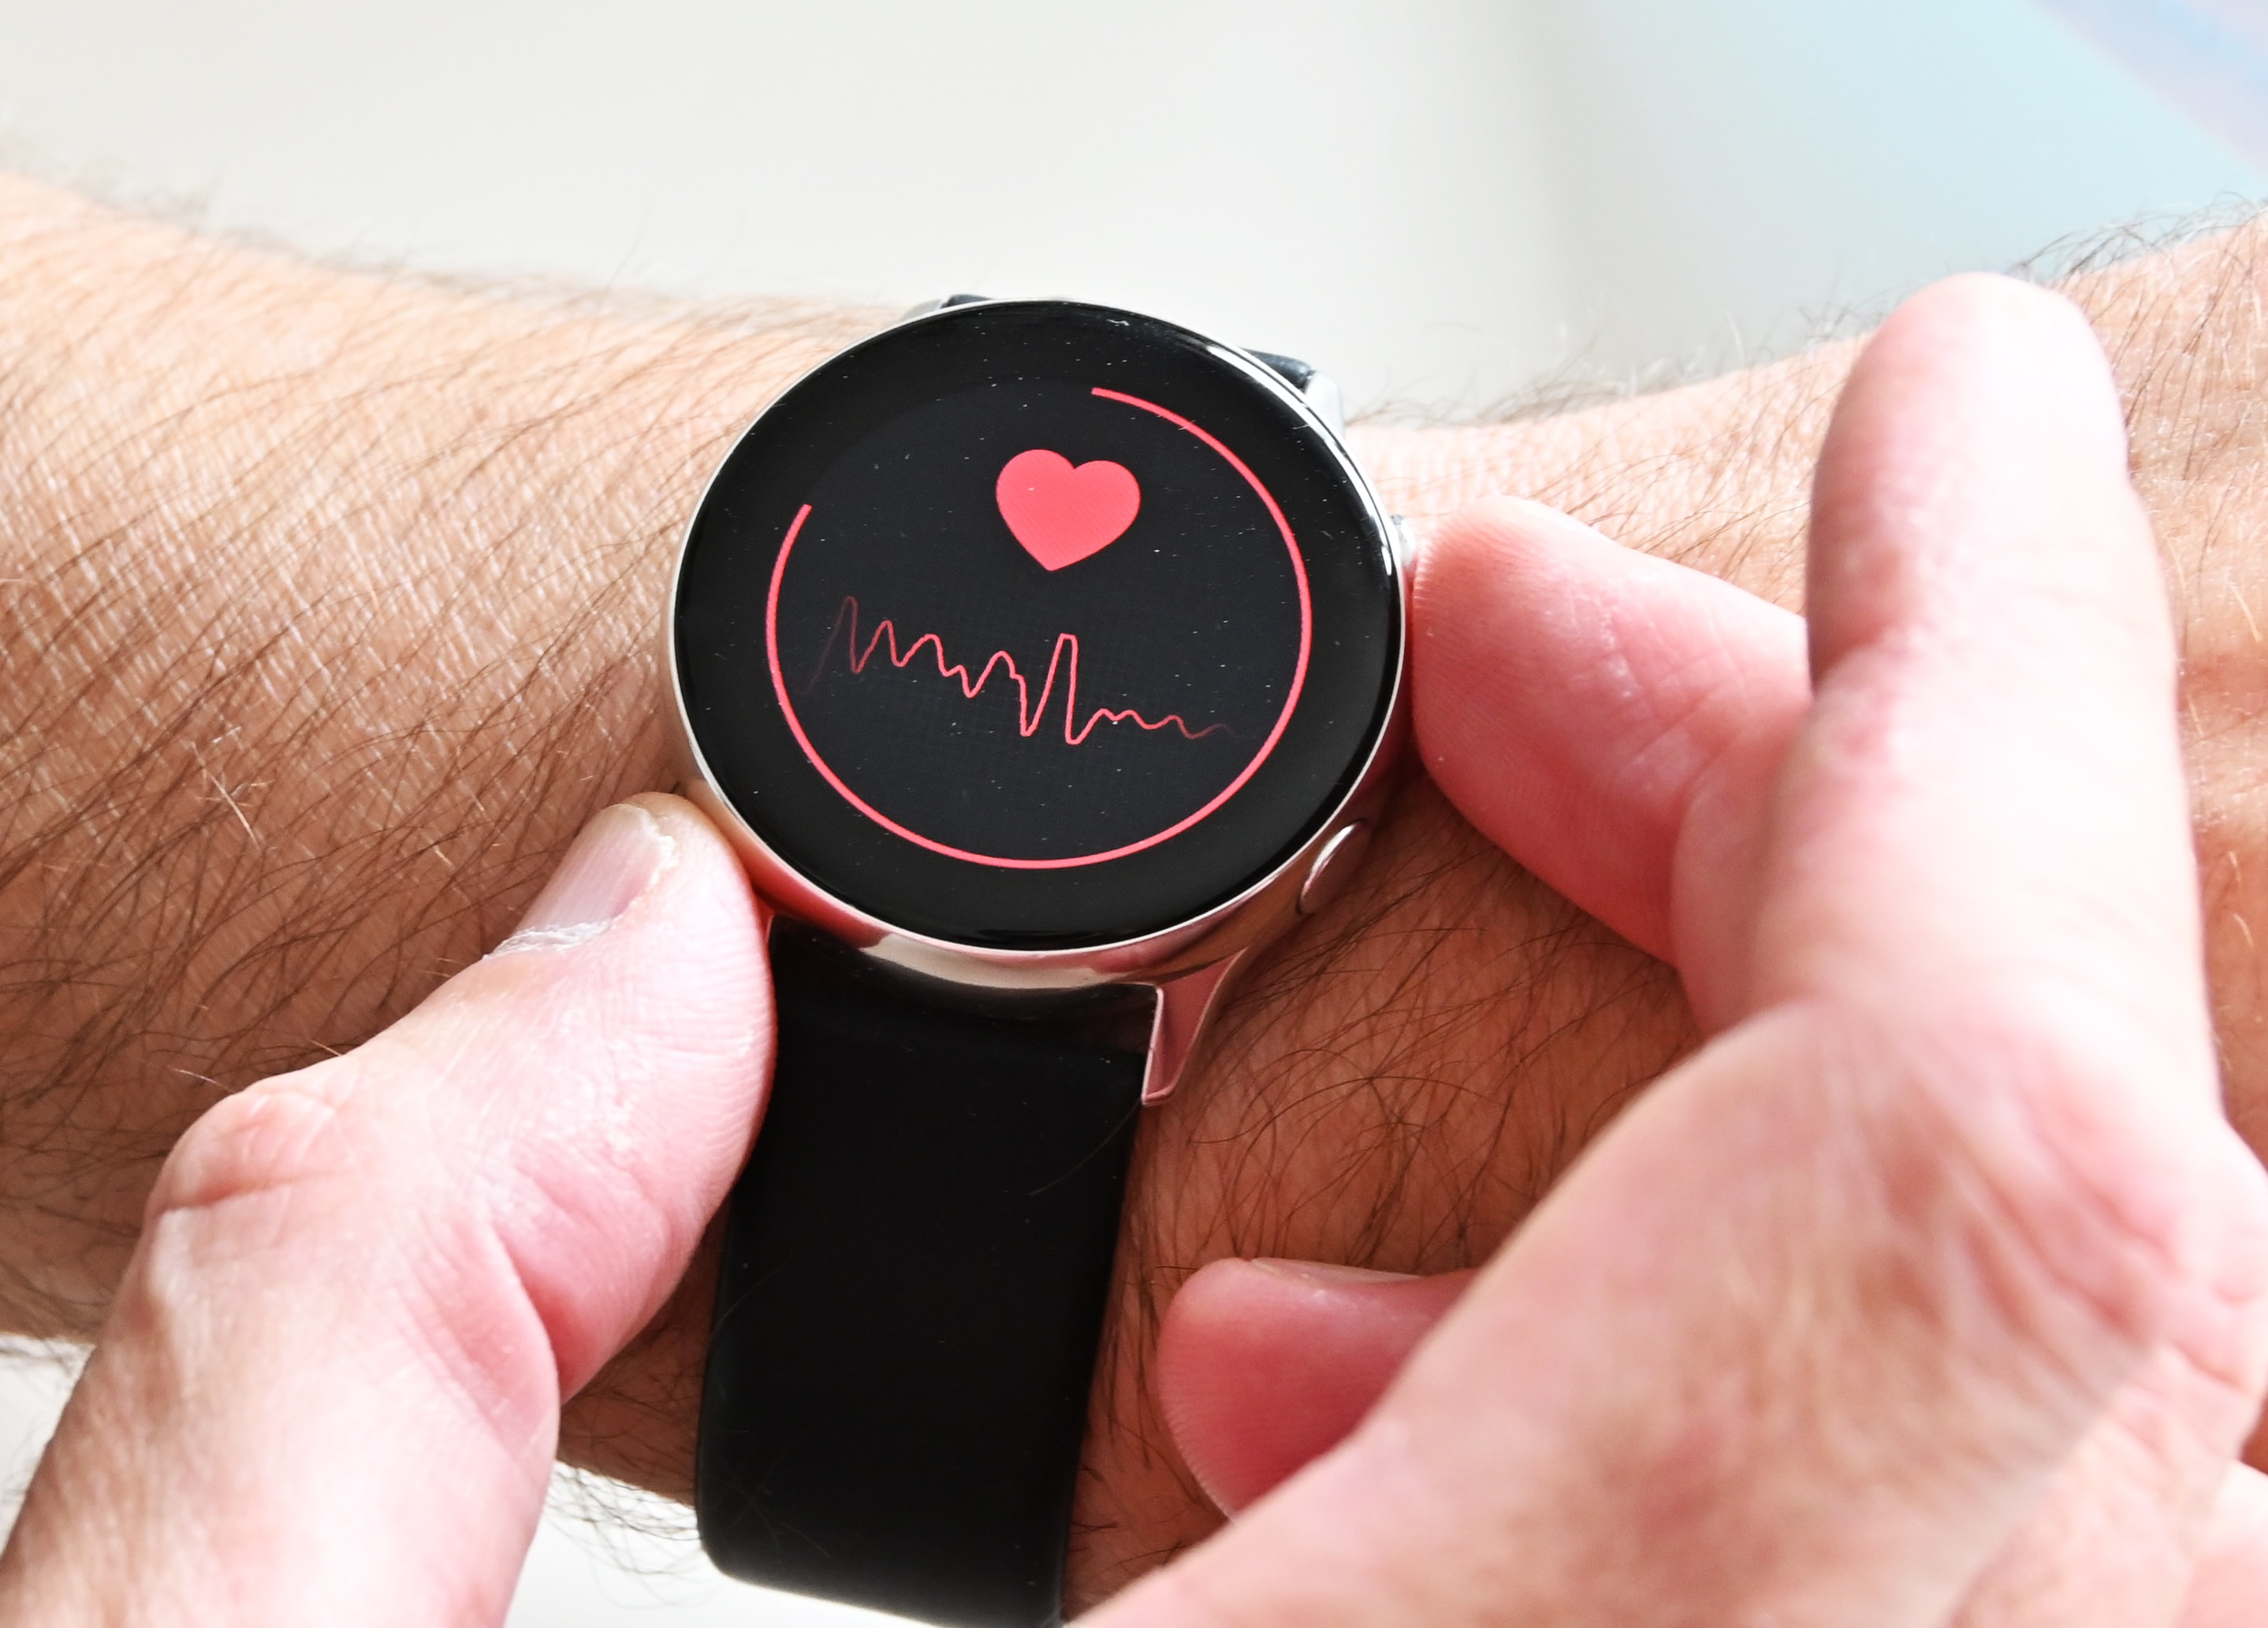
Mobile Health (mHealth) and Healthcare
Many chronic diseases are linked to mutable health behaviors
mHealth technology can enable proactive treatment with temporally-precise interventions
In mHealth, missingness is common and arises from multiple causes
Current mHealth systems use simple imputation methods (e.g. KNN) or do not compute biomarkers
Notes:
We frame our challenge around mobile health, the study of how mobile devices can be used to track and enable healthy behaviors to hopefully prevent chronic diseases
This is typically done through sensors that continuously and noninvasively monitor our given conditions.

Slide 3
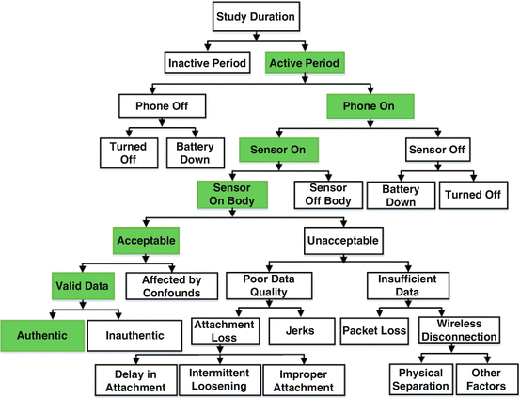
Mobile Health (mHealth) and Healthcare
Many chronic diseases are linked to mutable health behaviors
mHealth technology can enable proactive treatment with temporally-precise interventions
In mHealth, missingness is common and arises from multiple causes
Current mHealth systems use simple imputation methods (e.g. KNN) or do not compute biomarkers given missingness
Causes of mHealth Missingness [1]
[1] Rahman, M., Ali, N., Bari, R., Saleheen, N., al’Absi, M., Ertin, E., ... & Kumar, S. (2017). mdebugger: Assessing and diagnosing the fidelity and yield of mobile sensor data. In Mobile Health (pp. 121-143). Springer, Cham.
Notes:
However, missingness in mHealth sensors is both common and complex due to many different sources, and if any sensor modality is missing, we may lose the chance for a health intervention.

Slide 4
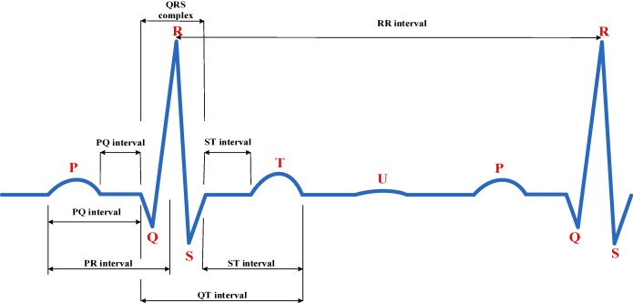
Defining mHealth Pulsative Signals
Pulsative Signals = quasi-periodic + well-defined specific morphologies
Examples: electrocardiogram (ECG), photoplethysmography (PPG), arterial blood pressure (ABP), etc.
Motivation for Imputation
Rich quasiperiodic information
Directly impacts clinical downstream tasks
Supports interpretability
ECG Signal with
Annotated Morphologies [2]
[2] Pombo, Nuno & Silva, Bruno & Pinho, André & Garcia, Nuno. (2020). Classifier Precision Analysis for Sleep Apnea Detection Using ECG Signals. IEEE Access. 8. 1-1. 10.1109/ACCESS.2020.3036024.
Notes:
A subset of these sensors focus on pulsative signals. Pulsative signals are quasi-periodic, due to their cardiopulmonary origin, and have well-defined specific morphologies that will depend on a user’s given health conditions.

Slide 5
Defining mHealth Pulsative Signals
Pulsative Signals = quasi-periodic + well-defined specific morphologies
Examples: electrocardiogram (ECG), photoplethysmography (PPG), arterial blood pressure (ABP), etc.
Well-defined Imputation Task
Rich quasiperiodic information
Directly impacts clinical downstream tasks
Supports interpretability
ECG Signal with
Annotated Morphologies [2]
[2] Pombo, Nuno & Silva, Bruno & Pinho, André & Garcia, Nuno. (2020). Classifier Precision Analysis for Sleep Apnea Detection Using ECG Signals. IEEE Access. 8. 1-1. 10.1109/ACCESS.2020.3036024.
Notes:
This setting provides a novel and interesting context for the machine learning imputation community to focus on and address.

Slide 6
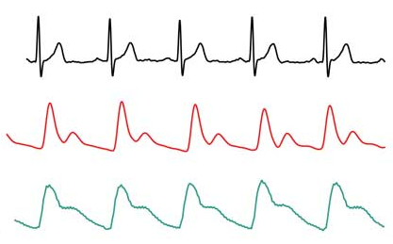
Defining mHealth Pulsative Signals
Pulsative Signals = quasi-periodic + well-defined specific morphologies
Examples: electrocardiogram (ECG), photoplethysmography (PPG), arterial blood pressure (ABP), etc.
Well-defined Imputation Task
Rich quasiperiodic information
impacts clinical downstream tasks
Supports interpretability
ECG, PPG, ABP signals [3]
Block of missingness
[3] FibriCheck . (n.d.). Fibricheck beat-to-beat accuracy compared with wearable ECG in broad dynamic range. Retrieved from https://www.fibricheck.com/fibricheck-beat-to-beat-accuracy-compared-with-wearable-ecg-in-broad-dynamic-range/
Notes:
Due to the quasiperiodic structure of these signals, there is an emphasis on modeling information across time to borrow information across quasi-periods

Slide 7
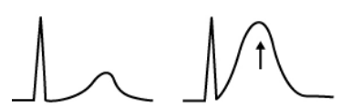
Defining mHealth Pulsative Signals
Pulsative Signals = quasi-periodic + well-defined specific morphologies
Examples: electrocardiogram (ECG), photoplethysmography (PPG), arterial blood pressure (ABP), etc.
Well-defined Imputation Task
Rich quasiperiodic information
Directly impacts clinical downstream tasks
Supports interpretability
Effect of myocardial infarction
on ECG Morphology [4]
[4] ST segment elevation in acute myocardial ischemia and differential diagnoses. ECG & ECHO Learning. (2021, July 14). Retrieved October 21, 2022, from https://ecgwaves.com/topic/ecg-st-elevation-segment-ischemia-myocardial-infarction-stemi/
Notes:
Each of the specific morphological properties have clinical significance, so imputation performance directly impacts downstream performance.

Slide 8
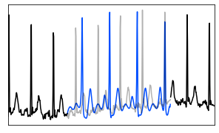
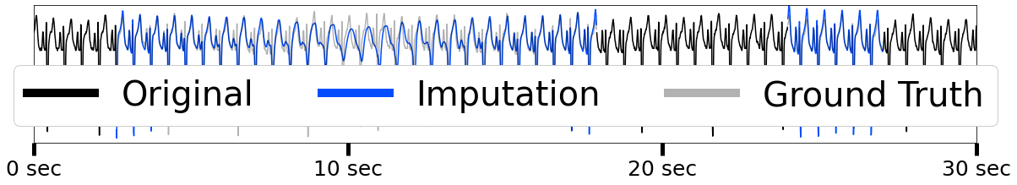
Defining mHealth Pulsative Signals
Pulsative Signals = quasi-periodic + well-defined specific morphologies
Examples: electrocardiogram (ECG), photoplethysmography (PPG), arterial blood pressure (ABP), etc.
Well-defined Imputation Task
Rich quasiperiodic information
Directly impacts clinical downstream tasks
Supports interpretability
Comparing Imputation with Ground Truth
Notes:
Finally, the well-defined morphology supports interpretability. When we visualize the imputation,

Slide 9
Defining mHealth Pulsative Signals
Pulsative Signals = quasi-periodic + well-defined specific morphologies
Examples: electrocardiogram (ECG), photoplethysmography (PPG), arterial blood pressure (ABP), etc.
Well-defined Imputation Task
Rich quasiperiodic information
Directly impacts clinical downstream tasks
Supports interpretability
Comparing Imputation with Ground Truth
S wave valley too deep
Incorrect Rhythm
Notes:
we can clearly understand in what ways the imputation method may be insufficient.

Slide 10
Our PulseImpute Challenge
A novel task of pulsative signal imputation
Key features:
Leverages public datasets
Real-world mHealth missingness patterns
Performance metrics:
Reconstruction error
Downstream task performance following imputation (e.g. heartbeat detection)
 | Our PulseImpute Challenge | Standard Imputation Datasets [4, 5] | mHealth systems’ Imputation [6,7] | Pulsative Signal Imputation [8,9]
mHealth Pulsative Signals | ✓ |  | ✓
Publicly Available Data | ✓ | ✓ |  | ✓
Realistic Missingness | ✓ | ✓ | ✓
Directly Evaluates Imputation | ✓ | ✓ |  | ✓
Comprehensive Benchmarks | ✓ | ✓
Downstream Tasks | ✓ | ✓ | ✓ | ✓
[4] Silva, I., Moody, G., Scott, D. J., Celi, L. A., & Mark, R. G. (2012, September). Predicting in-hospital mortality of icu patients: The physionet/computing in cardiology challenge 2012. In 2012 Computing in Cardiology (pp. 245-248). IEEE.
[5] Knowledge Discovery in Databases (2018, July). KDD cup of fresh air 2018 competition.
[6] Iranfar, A., Arza, A., & Atienza, D. (2021, November). Relearn: A robust machine learning framework in presence of missing data for multimodal stress detection from physiological signals. In 2021 43rd Annual International Conference of the IEEE Engineering in Medicine & Biology Society (EMBC) (pp. 535-541). IEEE.
[7] Sarker, H., Tyburski, M., Rahman, M. M., Hovsepian, K., Sharmin, M., Epstein, D. H., ... & Kumar, S. (2016, May). Finding significant stress episodes in a discontinuous time series of rapidly varying mobile sensor data. In Proceedings of the 2016 CHI conference on human factors in computing systems (pp. 4489-4501).
[8] Yang, F., Du, J., Lang, J., Lu, W., Liu, L., Jin, C., & Kang, Q. (2020). Missing value estimation methods research for arrhythmia classification using the modified kernel difference-weighted KNN algorithms. BioMed research international, 2020.
[9] Bashir, F., & Wei, H. L. (2018). Handling missing data in multivariate time series using a vector autoregressive model-imputation (VAR-IM) algorithm. Neurocomputing, 276, 23-30.
Notes:
There is very little prior work that studies mobile health pulsative signal imputation and none that do so in a comprehensive fashion, which motivates our development of this challenge.
Our pulseImpute challenge leverages public pulsative signal datasets with real-world mhealth missingness patterns, and we directly evaluate reconstruction performance and downstream tasks that directly depend on reconstruction quality.

Slide 11
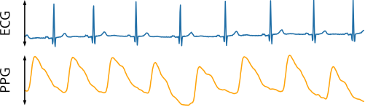
Challenge Setting and Details
Two Signal Domains:
ECG and PPG
Two Methods for Generating Missingness:
Systematically ablating percentages of the data according to mHealth missingness paradigms
or
Applying extracted mHealth missingness patterns created during field studies
[10] Floogan. (2021, August). File:sample biosignals (ECG, PPG, RIP).SVG. Wikipedia. Retrieved October 21, 2022, from https://en.wikipedia.org/wiki/File:Sample_Biosignals_(ECG,_PPG,_RIP).svg
Notes:
In our challenge, we focus on two domains, ECG and PPG. ECG signals, pictured above, measure the electrical activity of the heart and PPG signals, pictured below measure blood volume changes in tissue.

Slide 12
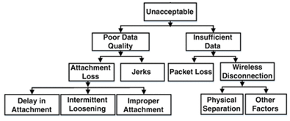
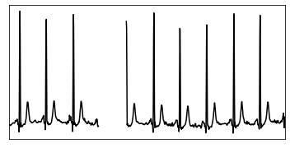
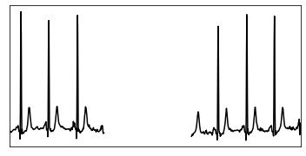
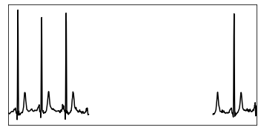
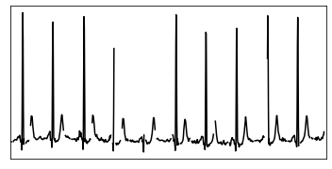
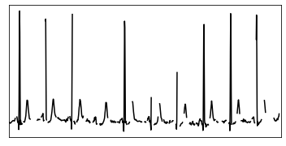
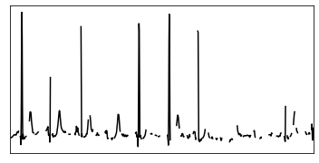
Challenge Setting and Details
Two Signal Domains:
ECG and PPG
Two Methods for Generating Missingness:
1) Systematically ablating percentages of the data according to mHealth missingness paradigms
or
Applying extracted mHealth missingness patterns created during field studies
mHealth Missingness Paradigms [1]
Extended Loss Setting to Mimic Poor Data Quality
Transient Loss Setting to Mimic Packet Loss
10% Loss
30% Loss
50% Loss
10% Loss
30% Loss
50% Loss
Notes:
We have two different methods for generating missingness in our challenge. The first focuses on systematically ablating percentages of data.
On the bottom left, we have the extended loss setting to mimic poor data quality and on the bottom right, we have the transient loss setting to mimic packet loss

Slide 13
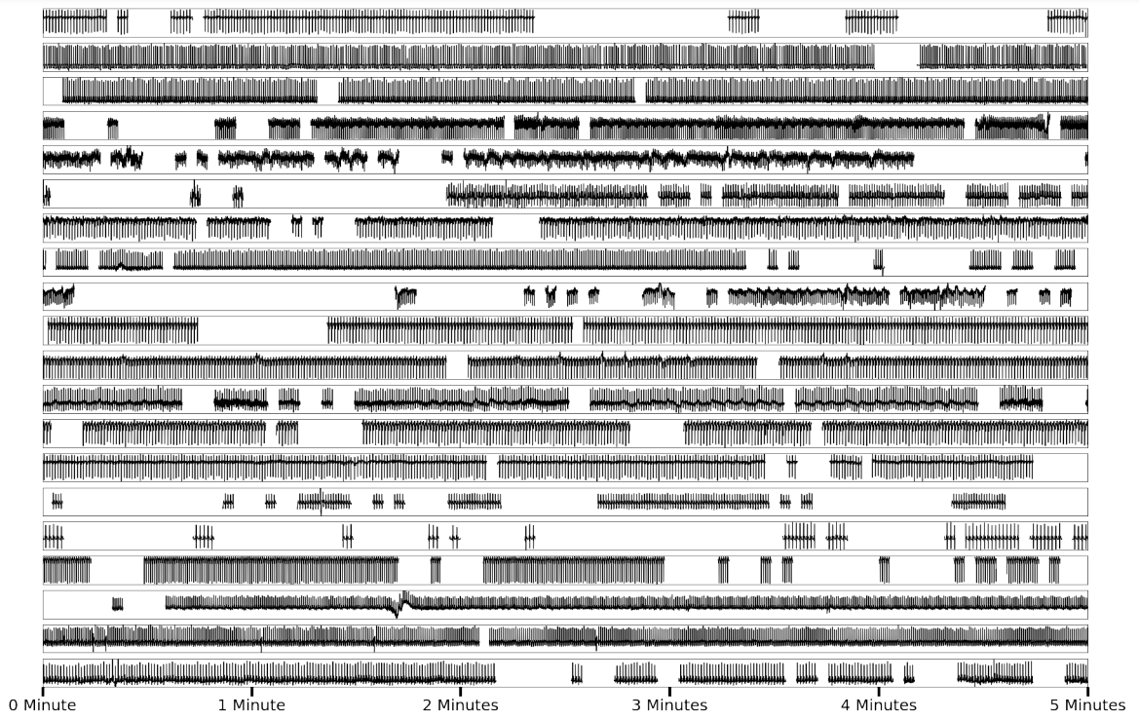
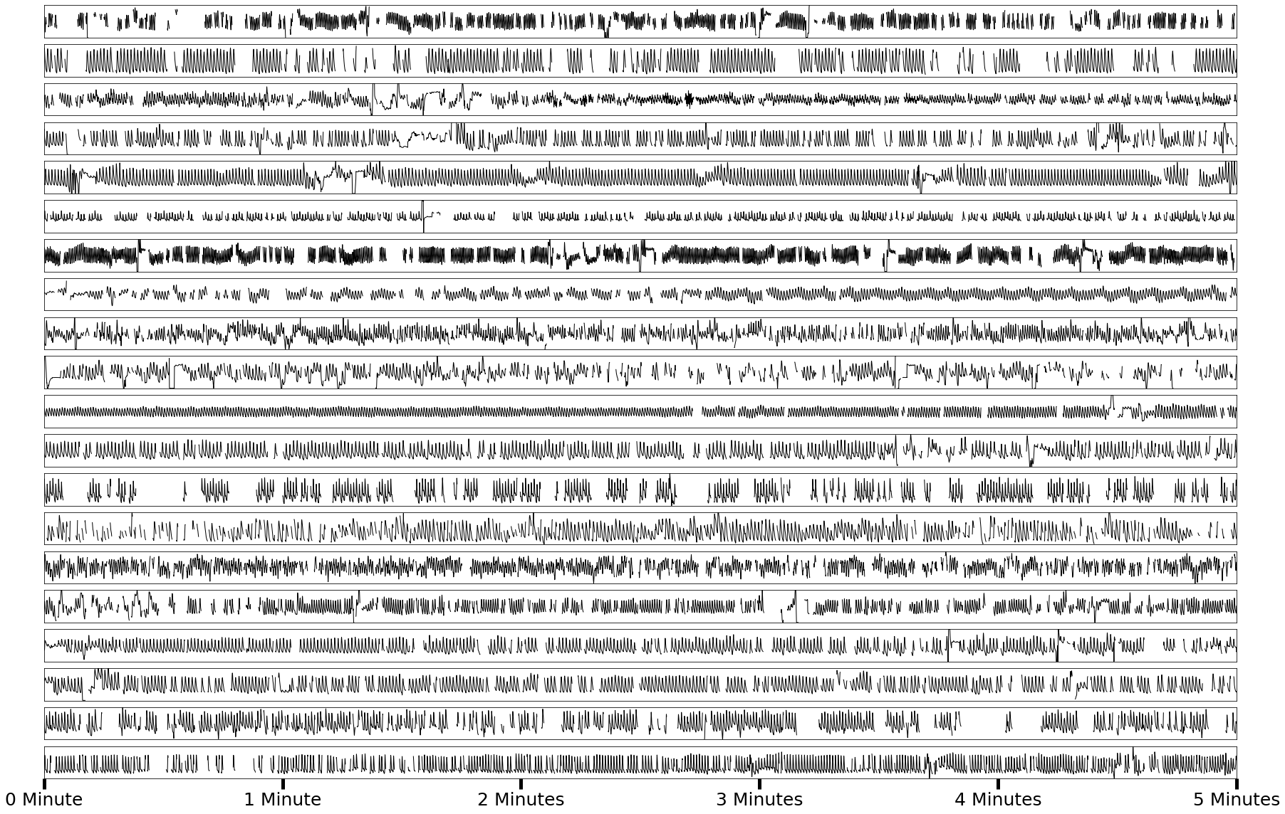
Challenge Setting and Details
Two Signal Domains:
ECG and PPG
Two Methods for Generating Missingness:
1) Systematically ablating percentages of the data according to mHealth missingness paradigms
or
2) Applying extracted mHealth missingness patterns created during field studies
ECG Signals with Extracted ECG mHealth Missingness
PPG Signals with Extracted PPG mHealth Missingness
Notes:
The second method for generating missingness is by extracting missingness patterns from real mhealth field studies, and applying them onto our data. On the right side, we can see ECG and PPG signals applied with their respective misssingness patterns.

Slide 14
Benchmarked Time-series Imputation Methods
Classical
Deep Learning
Neighbor-based
Statistics-based
Freq-based
RNN
Transformer
Linear Interpolation
Mean filling
FFT-based Imputer [11]
No GAN
GAN
DeepMVI* [14], Vanilla [15], Conv9 [16]
BRITS* [12]
NAOMI* [13], BRITS w/ GAIL [13]
Strong inductive bias for quasiperiodic data
However Transformers are plagued by a lack of Local Context
* SOTA methods for time-series imputation
Long-term dependencies difficult
Generative Adversarial Imitation Learning for generation
[11] Rahman, S. A., Huang, Y., Claassen, J., Heintzman, N., & Kleinberg, S. (2015). Combining Fourier and lagged k-nearest neighbor imputation for biomedical time series data. Journal of biomedical informatics, 58, 198-207.
[12] Cao, W., Wang, D., Li, J., Zhou, H., Li, L., & Li, Y. (2018). Brits: Bidirectional recurrent imputation for time series. Advances in NeurIPS, 31.
[13] Liu, Y., Yu, R., Zheng, S., Zhan, E., & Yue, Y. (2019). NAOMI: Non-autoregressive multiresolution sequence imputation. Advances in NeurIPS, 32.
[14] Bansal, P., Deshpande, P., & Sarawagi, S. (2021). Missing value imputation on multidimensional time series.
[15] Devlin, J., Chang, M. W., Lee, K., & Toutanova, K. (2018). Bert: Pre-training of deep bidirectional transformers for language understanding. arXiv preprint arXiv:1810.04805.
[16] Li, S., Jin, X., Xuan, Y., Zhou, X., Chen, W., Wang, Y. X., & Yan, X. (2019). Enhancing the locality and breaking the memory bottleneck of transformer on time series forecasting. Advances in neural information processing systems, 32.
Notes:
Our PulseImpute challenge covers a comprehensive set of baselines, ranging from classical methods to deep learning ones. The FFT-based imputer is one of the few prior works that utilizes frequency information. RNN-based methods have difficulty propagating information over long missingness gaps, and therefore, some methods have been augmented with GANs. Transformer-based imputation methods have also been developed and they have a strong inductive bias for our setting, but they are plagued by a lack of local context in their key/query comparisons.

Slide 15
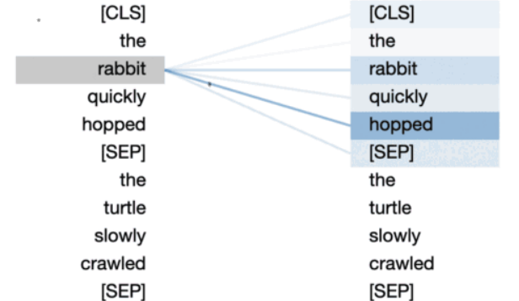
Novel Architecture that Exploits Quasiperiodicity
Self-attention’s pairwise comparisons can compare wave shapes across quasiperiods
BERT’s Vanilla Transformer
Self-Attention Weights on Word Tokens
[17] Vig, J. (2022, April 20). Deconstructing Bert, part 2: Visualizing The inner workings of attention. Medium. Retrieved October 21, 2022, from https://towardsdatascience.com/deconstructing-bert-part-2-visualizing-the-inner-workings-of-attention-60a16d86b5c1
Notes:
Self-attention was developed originally to compare word tokens, as demonstrated below, and they have a strong inductive bias in our setting because we can use self-attention to compare wave shapes across quasi-periods

Slide 16
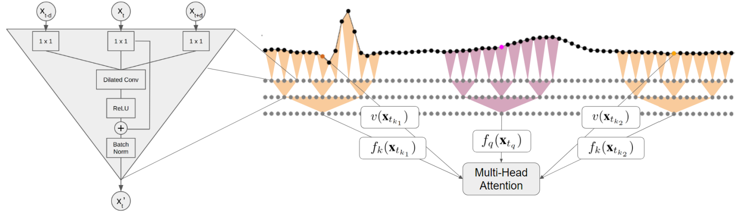
Novel Architecture that Exploits Quasiperiodicity
Self-attention’s pairwise comparisons can compare wave shapes across quasiperiods
Efficiently increase local context via bottleneck dilated convolution (BDC) self-attention module
Our BDC Self-Attention
Notes:
However, in order to do so, we must increase the local context in the query/key functions, which we do with our BDC self-attention module. This allows us for the efficient comparison of waveform shapes comprising 100s of samples.

Slide 17
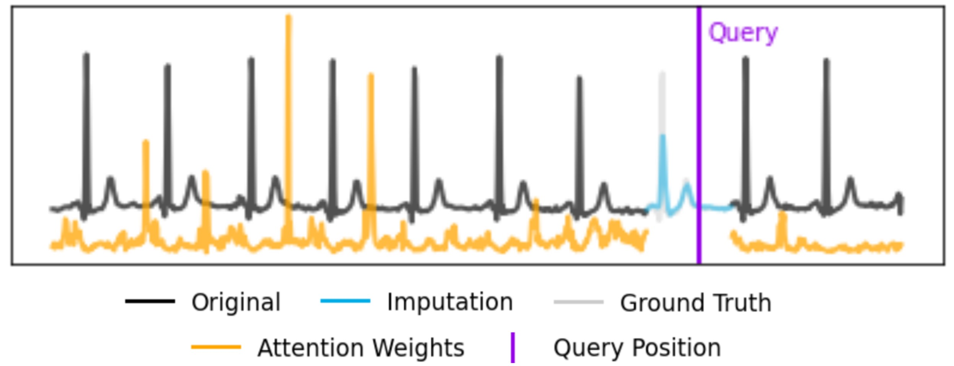
Novel Architecture that Exploits Quasiperiodicity
Self-attention’s pairwise comparisons can compare wave shapes across quasiperiods
Efficiently increase local context via bottleneck dilated convolution (BDC) self-attention module
BDC exploits quasiperiodicity by attending to locations similar in shape
Notes:
Through this attention visualization, we see that BDC transformer is able to exploit quasiperiodicity by attending to locations similar in shape.

Slide 18
Results
Notes:
Now we would like to go over results

Slide 19
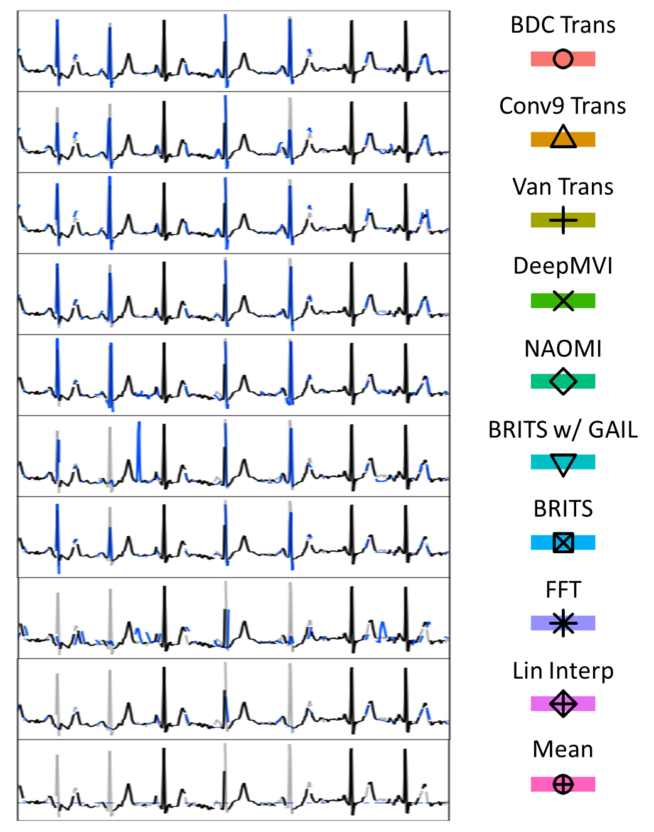
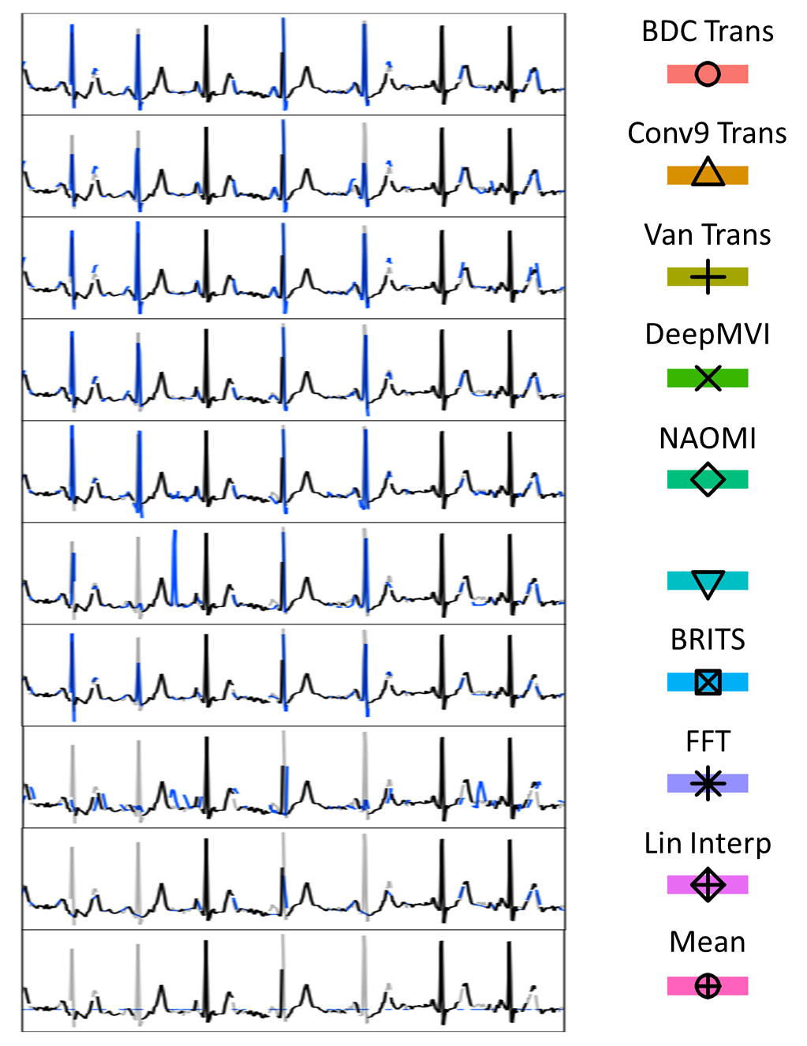
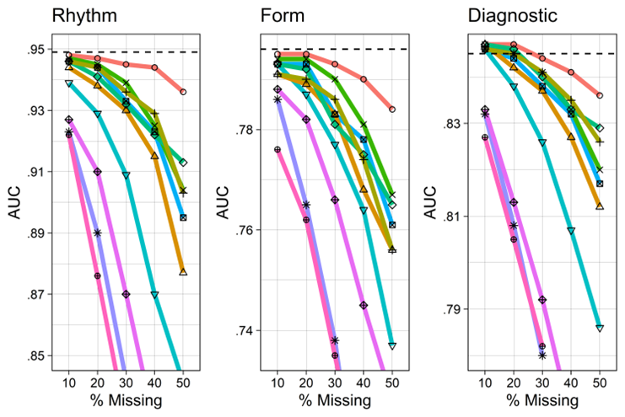
ECG Imputation with Transient Loss and Cardiac Classification
Visualization of Imputations
Most similar to prior work (e.g. BRITS). All methods perform well.
DL methods generally reconstruct peaks accurately, classical do not.
BDC Transformer has the best performance
Downstream Classification Results
Notes:
First, we discuss the results associated with ECG Imputation with Transient Loss and Cardiac Classification. In the transient loss setting, missingness gaps are typically quite short, which is similar to prior work, and as such, all methods perform well.

Slide 20
ECG Imputation with Transient Loss and Cardiac Classification
Visualization of Imputations
Most similar to prior work (e.g. BRITS). All methods perform well.
DL methods generally reconstruct peaks accurately, classical do not.
BDC Transformer has the best performance
Downstream Classification Results
Notes:
DL methods can generally reconstruct peaks accurately,

Slide 21
ECG Imputation with Transient Loss and Cardiac Classification
Visualization of Imputations
Most similar to prior work (e.g. BRITS). All methods perform well.
DL methods generally reconstruct peaks accurately, classical do not.
BDC Transformer has the best performance
Downstream Classification Results
Notes:
while classical cannot.

Slide 22
ECG Imputation with Transient Loss and Cardiac Classification
Visualization of Imputations
Most similar to prior work (e.g. BRITS). All methods perform well.
DL methods generally reconstruct peaks accurately, classical do not.
BDC Transformer has the best performance
Downstream Classification Results
Notes:
BDC transformer consistently has the best performance.

Slide 23
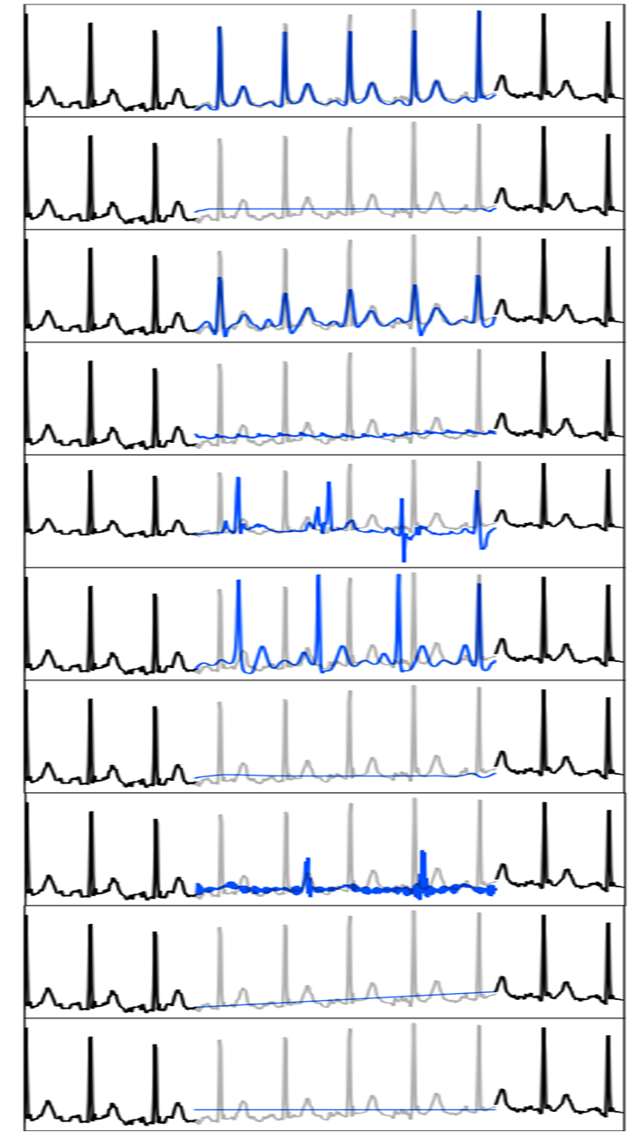
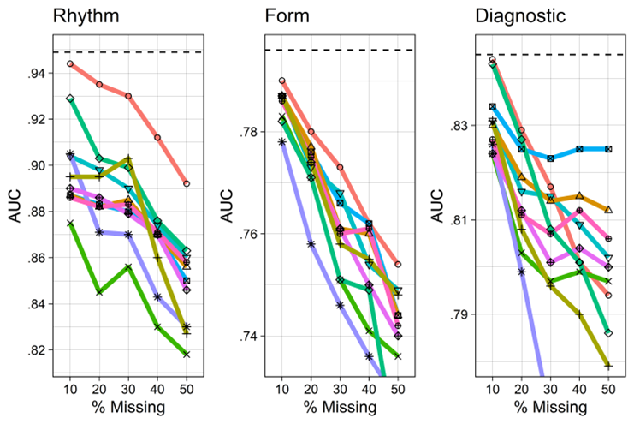
ECG Imputation with Extended Loss and Cardiac Classification
Visualization of Imputations
Higher difficulty imputing across longer gaps
GAN methods imitate shape, but do NOT reconstruct specific form and rhythm
BDC has best performance, usually correct on morphology and frequently correct on timing.
Downstream Classification Results
Notes:
The extended loss setting is much more difficult as methods must learn how to propagate information across longer missingness gaps.

Slide 24
ECG Imputation with Extended Loss and Cardiac Classification
Visualization of Imputations
Higher difficulty imputing across longer gaps
GAN methods imitate shape, but do NOT reconstruct specific form and rhythm
BDC has best performance, usually correct on morphology and frequently correct on timing.
Downstream Classification Results
Notes:
In particular, we see that GAN methods do very well in imitating the shape of the ECG structures, but do not reconstruct the specific form and rhythm found in the signal.

Slide 25
ECG Imputation with Extended Loss and Cardiac Classification
Visualization of Imputations
Higher difficulty imputing across longer gaps
GAN methods imitate shape, but do NOT reconstruct specific form and rhythm
BDC has best performance in Rhythm and Form, but suffers in the Diagnostic labels
Downstream Classification Results
Notes:
BDC has the best performance, being frequently correct on rhythm, usually correct on form and performing poorly in the diagnostic group.

Slide 26
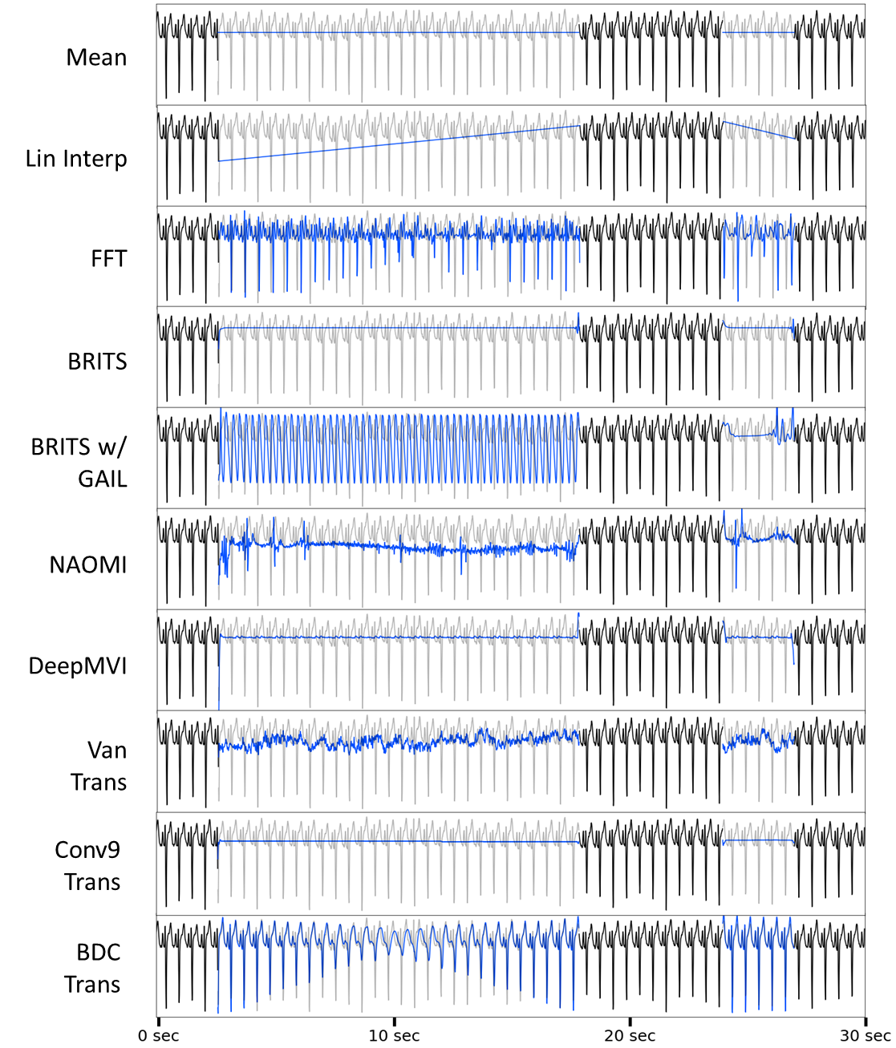
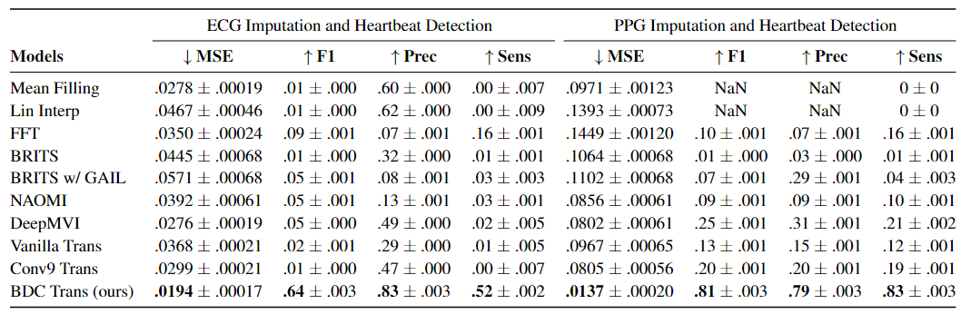
ECG Imputation with Extracted mHealth Missingness and Heartbeat Detection
Visualization of Imputations
Very long 5-minute signals (30,000 time points) with real ECG mHealth missingness
All methods perform poorly over longer missingness gaps (e.g. > 1 minute)
FFT and BDC are the best for reconstructing rhythm of heartbeats
BDC performs best overall
Downstream Heartbeat Detection Results
Notes:
Now we shift to the setting of ECG imputation with extracted mhealth missingness and heartbeat detection. In this setting, there are very long 5-minute signals and all methods perform poorly over the long missingness gaps that can last up to a minute long.

Slide 27
ECG Imputation with Extracted mHealth Missingness and Heartbeat Detection
Visualization of Imputations
Very long 5-minute signals (30,000 time points) with real ECG mHealth missingness
All methods perform poorly over longer missingness gaps (e.g. > 1 minute)
FFT and BDC are the best for reconstructing rhythm of heartbeats with BDC performing the best overall
Downstream Heartbeat Detection Results
Notes:
The two methods that exploit quasiperiodiicty, FFT and BDC, have the best downstream results, and reconstruct the heartbeat rhythm the best, but BDC easily is the best overall.

Slide 28
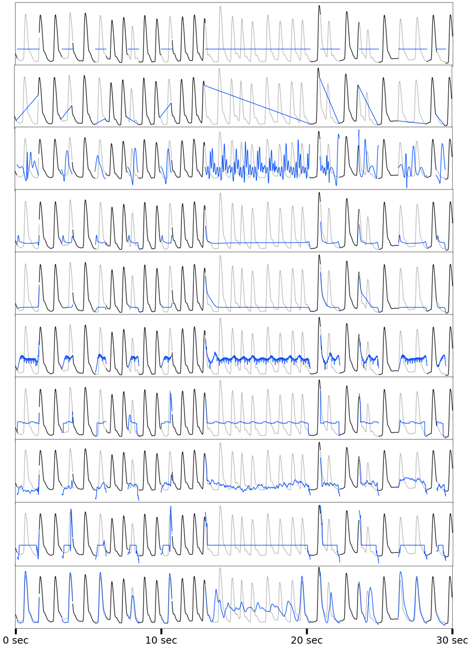
PPG Imputation with Extracted mHealth Missingness and Heartbeat Detection
Visualization of Imputations
Very long 5-minute signals (30,000 time points) with real PPG mHealth missingness
Simpler signal structure than ECG and all models perform better
Exploiting quasiperiodicity is useful across modalities, with FFT and BDC performing well, and BDC performing best overall
Downstream Heartbeat Detection Results
Notes:
In the PPG domain, the signals are much simpler morphologically, and overall all methods perform better. Finally we see that exploiting quasiperiodicity is useful across modalities for both PPG and ECG

Slide 29
Conclusion
PulseImpute is a novel imputation challenge for pulsative mHealth signals
Prior work time-series imputation work fails in our setting
Our proposed BDC Transformer demonstrates the potential of exploiting quasiperiodicty to achieve strong performance
More questions? Please feel free to contact me at maxxu05@gmail.com
Notes:
In conclusion, pulseimpute is a novel challenge of mhealth signals. We address a key gap in the imputation space, with most prior work failing in our setting, and our proposed BDC transformer demonstrates the potential of exploitingin quasiperiodicty to achieve strong performance
Thank you all for listening, and if you have any further questions, please feel free to reach out to me directly via email.

